Slide 1
Fuzzy Lookup
Matching textual data which are same in essence, …
…but can’t be matched…
…owing to spelling differences.
E.g. Mr. Andrew Hill vs. Hill, Andrew R.

Slide 2
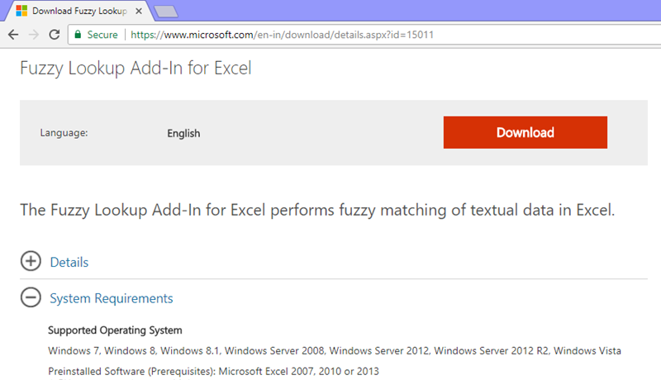
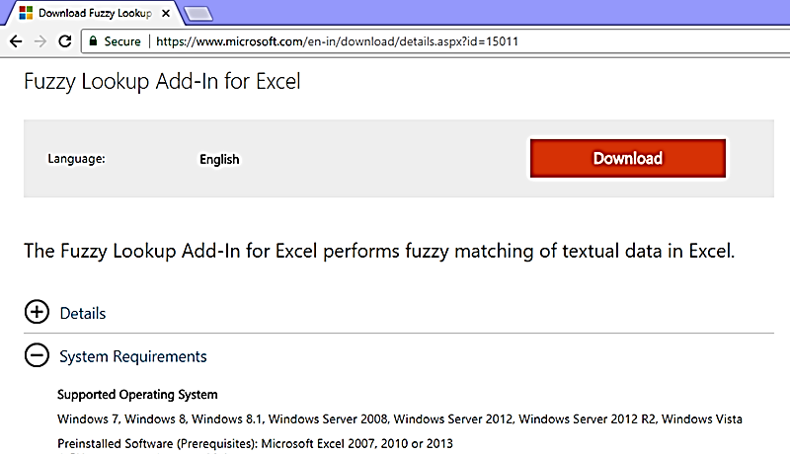
Download Fuzzy Lookup Add-in
Aura users should avoid installing it.

Slide 3

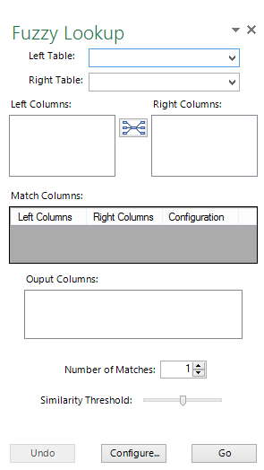

Fuzzy Lookup Add-in – a first look
1
2

Slide 4
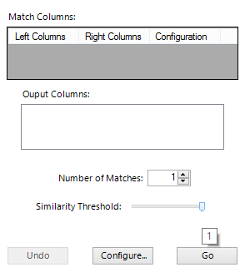
Fuzzy Lookup Add-in – a first look (…cont’d)
1
2

